Slide 1

EXPLORING THE CHINOOK MUSIC STORE DATABASE
Presented By : Piyush Bagade

Slide 2
Problem statement
As a data analyst at Chinook, your role is to examine music sales data to uncover meaningful patterns, understand customer behavior, and identify trends in the physical music industry. Based on these insights, you are expected to provide strategic recommendations that can help the company improve performance, optimize sales, and strengthen its position in the market.

Slide 3
From Music to Customer: Chinook Workflow
Phase 1
Phase 2
Phase 3
Phase 4
Phase 5
Content Management
Catalog Setup
User Interaction
Purchase Process
Payment & Delivery
Music data (artists, albums, tracks) is added and maintained.
Content is organized for easy browsing and search.
Customers explore, search, and select music.
Tracks are added, and invoices are generated during checkout.
Payments are processed and music is delivered digitally.

Slide 4
Data Overivew
Employee
Customer
Invoice
Media Type
Track
Employee_Id, LastName, FirstName, Title, ReportsTo, BirthDate, HireDate, Address, City, State, Country, PostalCode, Phone, Fax, Email
CustomerId, FirstName, LastName, Company, Address, City, State, Country, PostalCode, Phone, Fax, Email, SupportRepId
InvoiceId, CustomerId, InvoiceDate, BillingAddress, BillingCity, BillingState, BillingCountry, BillingPostalCode, Total
MediaTypeId, Name
TrackId, Name, AlbumId, MediaTypeId, GenreId, Composer, Milliseconds, Bytes, UnitPrice
Album
AlbumId, Title, ArtistId
Invoice Line
Album
Genre
Artist
Playlist Track
Playlist
InvoiceLineId, InvoiceId, TrackId, UnitPrice, Quantity
AlbumId, Title, ArtistId
GenreId, Name
ArtistId, Name
PlaylistId, TrackId
PlaylistId, Name

Slide 5
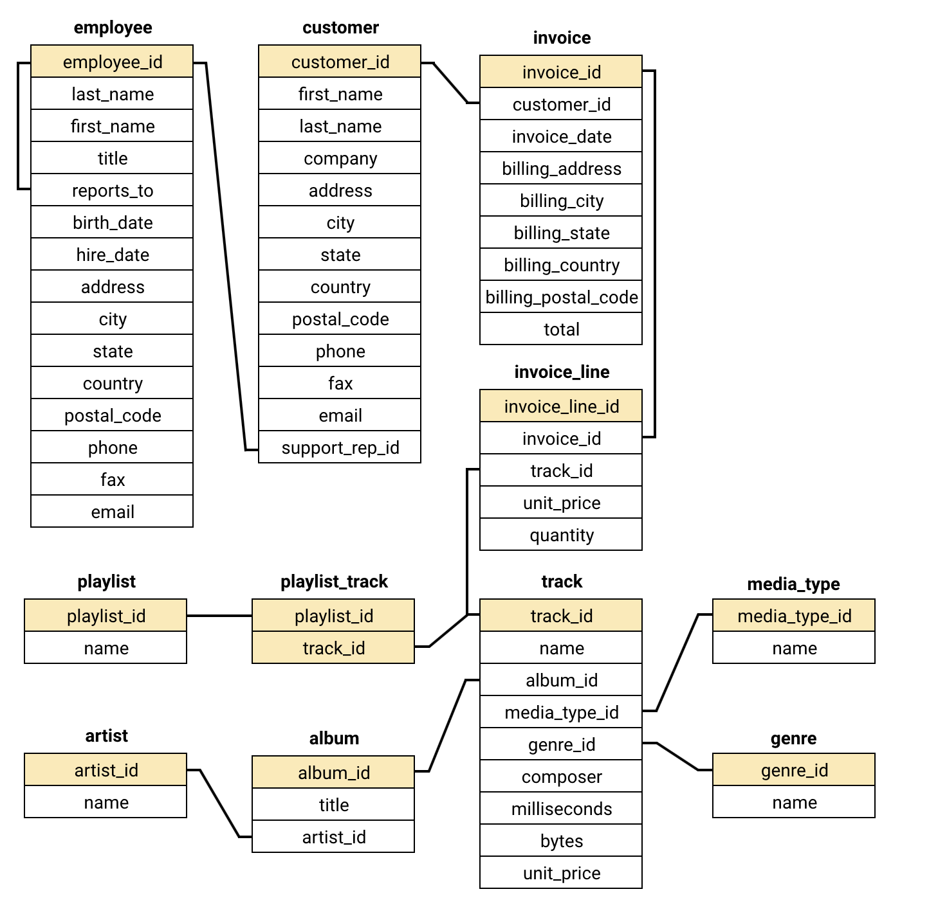
Database schema

Slide 6
Methodology
Step 1
Step 2
Step 3
Step 4
Step 5
Data Understanding
Data Preparation
Data Extraction
Analysis & Visualization
Insights & Interpretation
Analyzed database schema and table relationships.
Cleaned data and handled missing or inconsistent values.
Used SQL queries to retrieve relevant data insight
Applied aggregations and created charts for insights.
Identified trends, patterns, and business insights.

Slide 7
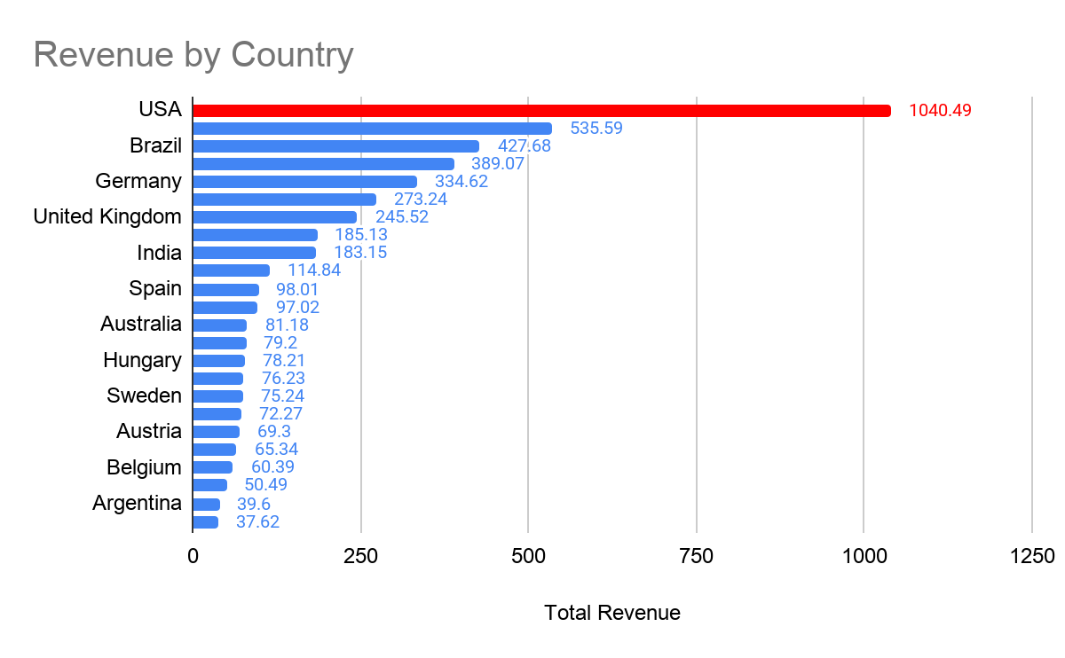
Sales Performance & Customer Behavior
The United States leads overall sales, contributing the largest share of total revenue across all regions.
Repeat purchase trends suggest a loyal customer base, with certain users consistently contributing to revenue growth.
Customer spending patterns differ widely by country, indicating strong opportunities in high-value but under-targeted markets.

Slide 8
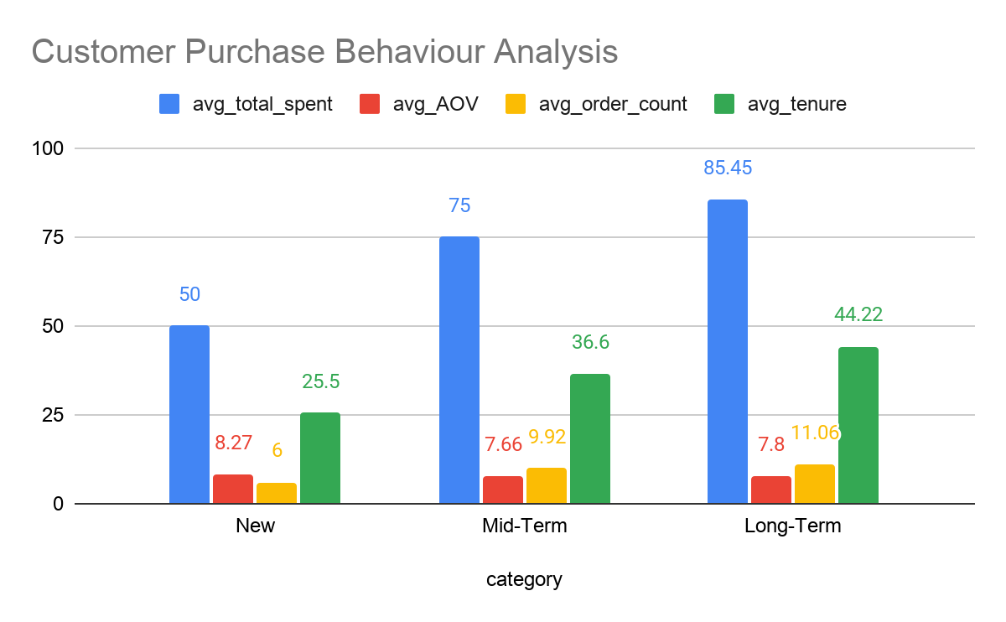
Customer Retention Drives Revenue Growth
“Revenue growth is driven by frequency, not basket size.”
Repeat customers generate more transactions, with long-term users averaging 11.06 orders compared to 6.00 orders for new customers (almost 2x higher).
Spending per order stays consistent across segments, with Average Order Value ranging narrowly between $7.66 and $8.27.
Customer lifetime value increases with tenure, as total spend rises from $50 (new customers) to $75 (mid-term) and $85 (long-term customers).

Slide 9
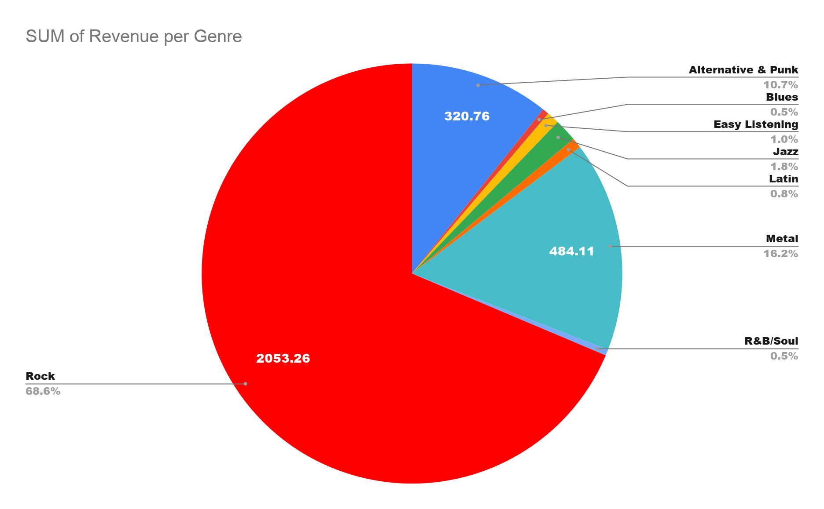
Genre Concentration & Market Opportunity
Rock music dominates revenue, contributing approximately 68.6% ($2053.26) of total sales across all regions.
Metal ($484.11 | 16.2%) and Alternative/Punk (~10.7%) form the secondary tier, showing consistent but significantly lower performance than Rock.
All other genres combined contribute less than 15%, with categories like Jazz, Latin, Blues, and Easy Listening each below ~2%, indicating limited market penetration.
Revenue is highly concentrated in a single genre, creating both dependency risk and diversification opportunity.

Slide 10
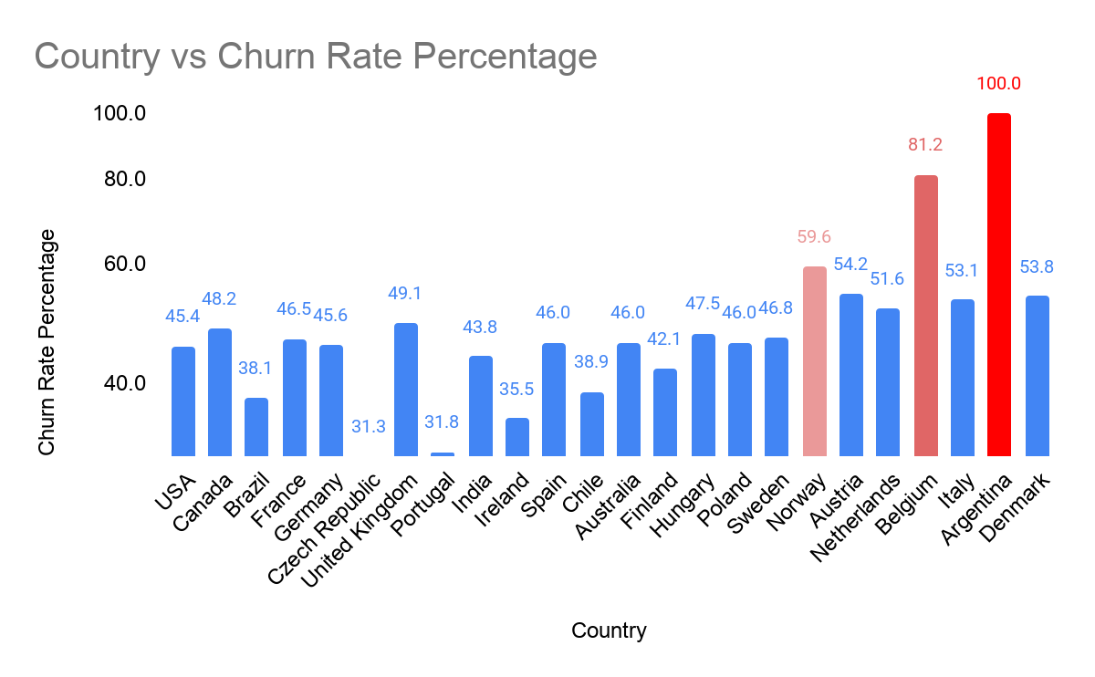
Churn Risk & Market Prioritization
Customer churn is highest in the USA (~45–48%), with Canada following closely at similar levels, indicating saturation and competitive pressure in mature markets.
Several European markets show extreme churn spikes, with countries like Italy (~81%) and Denmark (100%) signaling weak retention and possible product-market mismatch.
Stable mid-range churn (40–55%) across multiple regions suggests a consistent but improvable baseline customer experience.
Retention challenges vary significantly by region — a one-size-fits-all strategy will underperform.

Slide 11
Strategic Recommendations for Growth & Retention
Double Down on High-Value Markets
Action: Increase targeted campaigns in the United States and Canada
Why: Highest revenue contribution + strong repeat customers
Impact: +15–20% revenue growth potential
Introduce Tiered Pricing for Price-Sensitive Regions
Action: Launch budget-friendly bundles and regional pricing
Why: Improves accessibility in lower-spending markets
Impact: Expands customer base & boosts conversion rates

Slide 12
Build Strong Customer Loyalty Programs
Action: Rewards, subscriptions, and personalized offers
Why: Long-term users generate ~2x more orders
Impact: Higher retention & lifetime value (LTV)
4. Focus on High-Performing Genres
Action: Prioritize Rock, Metal, and Alternative/Punk catalogs
Why: Rock alone contributes ~68% of total sales
Impact: Maximized ROI on inventory & promotions

Slide 13
5. Reduce Churn in High-Risk Markets
Action: Retention campaigns in Italy, Denmark, and other high-churn regions
Why: Churn rates exceed 80–100% in some markets
Impact: Stabilized revenue & improved customer base
“Growth will come from scaling what works (top markets & genres) while fixing retention gaps in high-churn regions.

Slide 14
Conclusion
Sales outcomes differ significantly across regions, highlighting unequal growth opportunities in different markets.
Sustained revenue is largely driven by strong long-term customer relationships and repeat engagement.
A small number of leading music genres account for the majority of total sales.
Customer spending remains relatively stable, though purchase frequency varies across segments.
External market factors heavily influence customer purchasing behavior and demand patterns.
These insights enable more precise, data-driven strategies for improving performance and decision-making.

